Slide 1
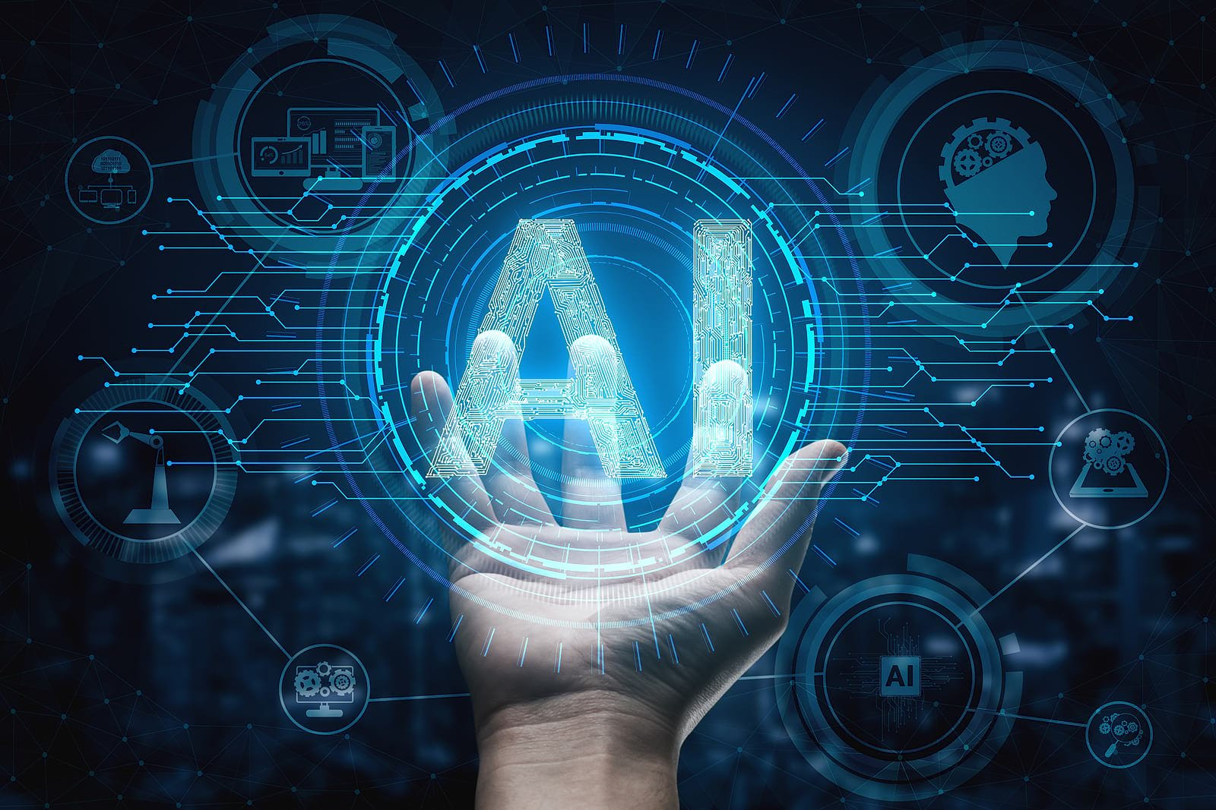
Module 6 ARTIFICIAL INTELLIGENCE
BY: Mohammad Tahir Mirji

Slide 2
Agenda
Basic Concept of Artificial Intelligence
The Necessity of Learning AI
Understanding Intelligence
What is Intelligence?
Types of Intelligence
Deep Dive into Machine Artificial Intelligence
Introduction to Neural Networks
Artificial Neural Network (ANN)
Convolution Neural Network (CNN)
Recurrent Neural Network (RNN)
Deep learning
Cognitive computing
Natural Language processing
Computer vision
Learn the application of AI in
Healthcare
Government
Manufacturing
Finance
Retail
Social Media

Slide 3
Basic Concept of Artificial Intelligence
Intelligence: The ability to learn and solve problems.
The most common answer that one expects is “to make computers intelligent so that they can act intelligently.
If the computers can, somehow, solve real-world problems, by improving on their own from past experiences, they would be called “intelligent”.
Thus, the AI systems are more generic(rather than specific), can “think” and are more flexible.
Intelligence, as we know, is the ability to acquire and apply knowledge.
Knowledge is the information acquired through experience.
Experience is the knowledge gained through exposure(training)
Summing the terms up, we get artificial intelligence as the “copy of something natural(i.e., human beings) ‘WHO’ is capable of acquiring and applying the information it has gained through exposure.”

Slide 4
The Necessity of Learning AI
They are known to learn, adapt and perform much faster than humans and are programmed to do so.
Robotics and integration with IoT devices have taken machines to think and work to a new level where they out-perform humans in their cognitive abilities and smarts.
Its importance lies in making our life easier. These technologies are a great asset to humans and are programmed to minimize human effort as much as possible.
They can operate in an automated fashion.
These machines speed up your tasks and processes with guaranteed accuracy and precision, making them a useful and valuable tool.
Apart from making the world an error-free place with their simple and everyday techniques, these technologies and applications are not only related to our ordinary and everyday life.

Slide 5
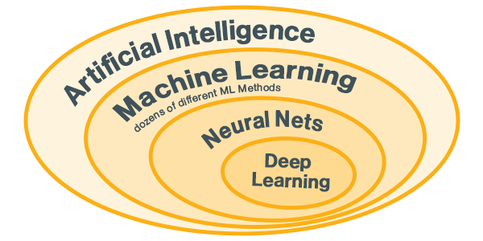
Understanding Intelligence
Artificial Intelligence includes the simulation process of human intelligence by machines and special computer systems.
The examples of artificial intelligence include learning, reasoning and self-correction. Applications of AI include speech recognition, expert systems, and image recognition and machine vision.
Machine learning is the branch of artificial intelligence, which deals with systems and algorithms that can learn any new data and data patterns.

Slide 6
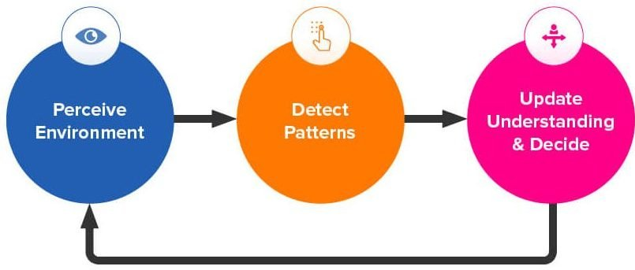
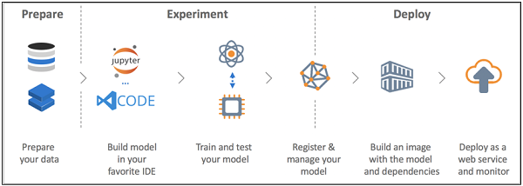

Slide 7
Understanding Intelligence
The ability of program which follows machine learning concepts is to improve its performance of observed data.
The main motive of data transformation is to improve its knowledge in order to achieve better results in the future, provide output closer to the desired output for that particular system.
Machine learning includes “pattern recognition” which includes the ability to recognize the patterns in data.
The patterns should be trained to show the output in desirable manner.
Data science, an interdisciplinary field that uses scientific and other methods to extract value from data, combines skills from fields such as statistics and computer science with business knowledge to analyze data collected from multiple sources.

Slide 8
What is Intelligence?
Machines that mimic human intelligence to perform tasks and can iteratively improve themselves based on the information they collect. AI manifests in a number of forms.
Intelligence, as we know, is the ability to acquire and apply knowledge. Knowledge is the information acquired through experience. Experience is the knowledge gained through exposure(training). Summing the terms up, we get artificial intelligence as the “copy of something natural(i.e., human beings) ‘WHO’ is capable of acquiring and applying the information it has gained through exposure.”
AI is much more about the process and the capability for superpowered thinking and data analysis than it is about any particular format or function. Although AI brings up images of high-functioning, human-like robots taking over the world, AI isn’t intended to replace humans. It’s intended to significantly enhance human capabilities and contributions. That makes it a very valuable business asset.

Slide 9
Types of Intelligence
There are other types of A.I. the more tech-oriented crowd observes.
Artificial narrow intelligence (ANI), which has a narrow range of abilities;
Artificial general intelligence (AGI), which is on par with human capabilities; or
Artificial superintelligence (ASI), which is more capable than a human.
Artificial narrow intelligence (ANI), also referred to as weak AI or narrow AI, is the only type of artificial intelligence we have successfully realized to date. Narrow AI is goal-oriented, designed to perform singular tasks - i.e. facial recognition, speech recognition/voice assistants, driving a car, or searching the internet - and is very intelligent at completing the specific task it is programmed to do.

Slide 10
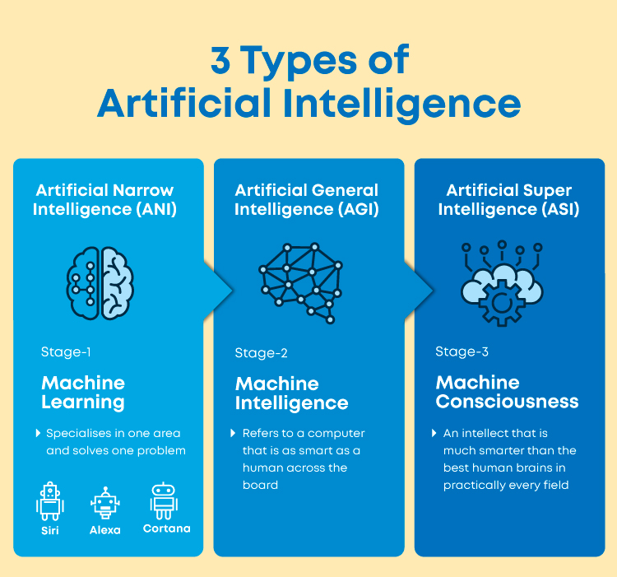

Slide 11
While these machines may seem intelligent, they operate under a narrow set of constraints and limitations, which is why this type is commonly referred to as weak AI. Narrow AI doesn’t mimic or replicate human intelligence, it merely simulates human behavior based on a narrow range of parameters and contexts.
Consider the speech and language recognition of the Siri virtual assistant on iPhones, vision recognition of self-driving cars, and recommendation engines that suggest products you make like based on your purchase history. These systems can only learn or be taught to complete specific tasks.
Narrow AI has experienced numerous breakthroughs in the last decade, powered by achievements in machine learning and deep learning. For example, AI systems today are used in medicine to diagnose cancer and other diseases with extreme accuracy through replication of human-esque cognition and reasoning.

Slide 12
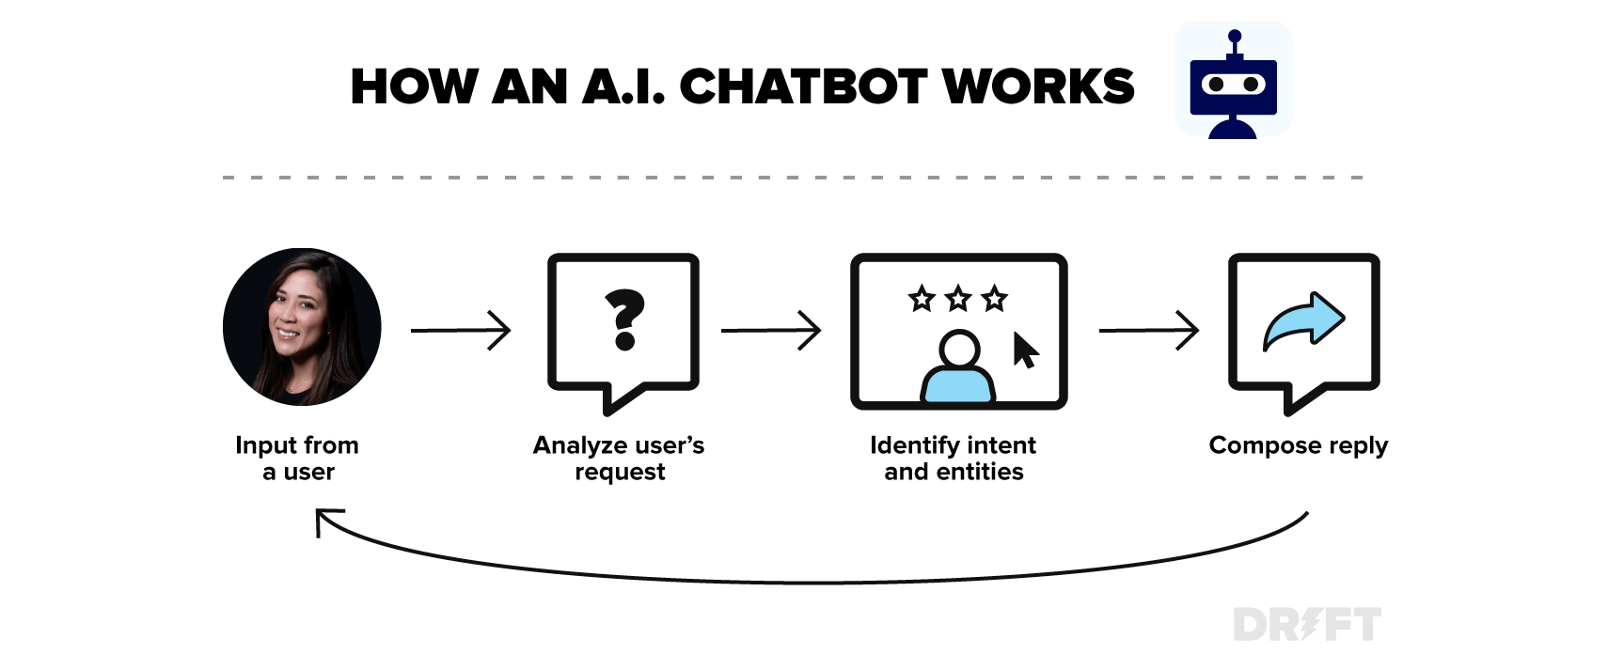

Slide 13
Examples of narrow AI:
Rankbrain by Google / Google Search
Siri by Apple, Alexa by Amazon, Cortana by Microsoft and other virtual assistants
IBM’s Watson
Image / facial recognition software
Disease mapping and prediction tools
Manufacturing and drone robots
Email spam filters / social media monitoring tools for dangerous content
Entertainment or marketing content recommendations based on watch/listen/purchase behaviour
Self-driving cars

Slide 14
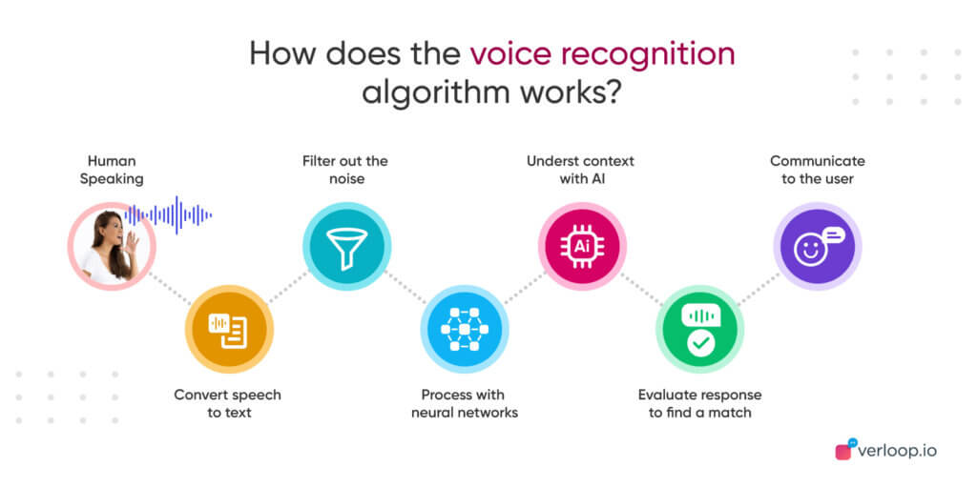

Slide 15
Artificial general intelligence (AGI), also referred to as strong AI or deep AI, is the concept of a machine with general intelligence that mimics human intelligence and/or behaviours, with the ability to learn and apply its intelligence to solve any problem. AGI can think, understand, and act in a way that is indistinguishable from that of a human in any given situation.
AI researchers and scientists have not yet achieved strong AI. To succeed, they would need to find a way to make machines conscious, programming a full set of cognitive abilities. Machines would have to take experiential learning to the next level, not just improving efficiency on singular tasks, but gaining the ability to apply experiential knowledge to a wider range of different problems.
Strong AI uses a theory of mind AI framework, which refers to the ability to discern needs, emotions, beliefs and thought processes of other intelligent entitles. Theory of mind level AI is not about replication or simulation, it’s about training machines to truly understand humans.

Slide 16
Artificial super intelligence (ASI), is the hypothetical AI that doesn’t just mimic or understand human intelligence and behavior; ASI is where machines become self-aware and surpass the capacity of human intelligence and ability.
Superintelligence has long been the muse of dystopian science fiction in which robots overrun, overthrow, and/or enslave humanity. The concept of artificial superintelligence sees AI evolve to be so akin to human emotions and experiences, that it doesn’t just understand them, it evokes emotions, needs, beliefs and desires of its own.
In addition to replicating the multi-faceted intelligence of human beings, ASI would theoretically be exceedingly better at everything we do; math, science, sports, art, medicine, hobbies, emotional relationships, everything. ASI would have a greater memory and a faster ability to process and analyse data and stimuli. Consequently, the decision-making and problem solving capabilities of super intelligent beings would be far superior than those of human beings.

Slide 17
Is AI dangerous? Will robots take over the world?
AI’s rapid growth and powerful capabilities have made many people paranoid about the “inevitability” and proximity of an AI takeover.
Mark Zuckerberg is less concerned about this hypothetical control problem, saying the positives of AI outweigh potential negatives.
Most researchers agree that superintelligent AI is unlikely to exhibit human emotions, and we have no reason to expect ASI will become malevolent. When considering how AI might become a risk, two key scenarios have been determined as most likely.
AI could be programmed to do something devastating.
Autonomous weapons are AI systems programmed to kill. In the hands of the wrong person, autonomous weapons could inadvertently lead to an AI war, and mass casualties, potentially even the end of humanity. Such weapons may be designed to be extremely difficult to “turn off”, and humans could plausibly, rapidly lose control. This risk is prevalent even with narrow AI, but grows exponentially as autonomy increases.

Slide 18
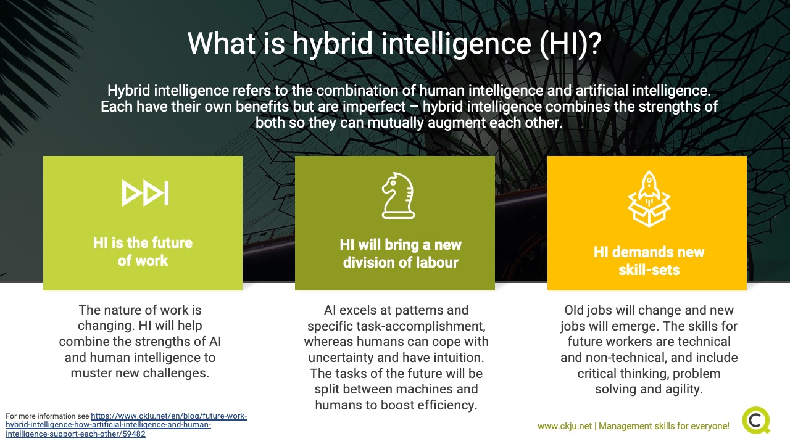

Slide 19
What is the future of AI?
This is the burning question. Are we capable of achieving strong AI or artificial superintelligence? Are they even possible? Optimistic experts believe AGI and ASI are possible, but it’s very difficult to determine how far away we are from realizing these levels of AI.
The line between computer programs and AI is opaque. Mimicking narrow elements of human intelligence and behavior is relatively easy, but creating a machine version of human consciousness is a totally different story.
While AI is still in its infancy, and the quest for strong AI was long thought to be science fiction, breakthroughs in machine and deep learning indicate that we may need to be more realistic about the possibility of achieving artificial general intelligence in our lifetime.
It’s daunting to consider a future where machines are better than humans at the very things that make us human.
We cannot accurately predict all the impacts AI advancements will have on our world, but the eradication of things like disease and poverty is not unfathomable.

Slide 20
What is Neural networks ?
Neural networks are artificial systems that were inspired by biological neural networks.
These systems learn to perform tasks by being exposed to various datasets and examples without any task-specific rules.
The idea is that the system generates identifying characteristics from the data they have been passed without being programmed with a pre-programmed understanding of these datasets.
Neural networks are based on computational models for threshold logic. Threshold logic is a combination of algorithms and mathematics.
Neural networks are based either on the study of the brain or on the application of neural networks to artificial intelligence. The work has led to improvements in finite automata theory.
More…

Slide 21
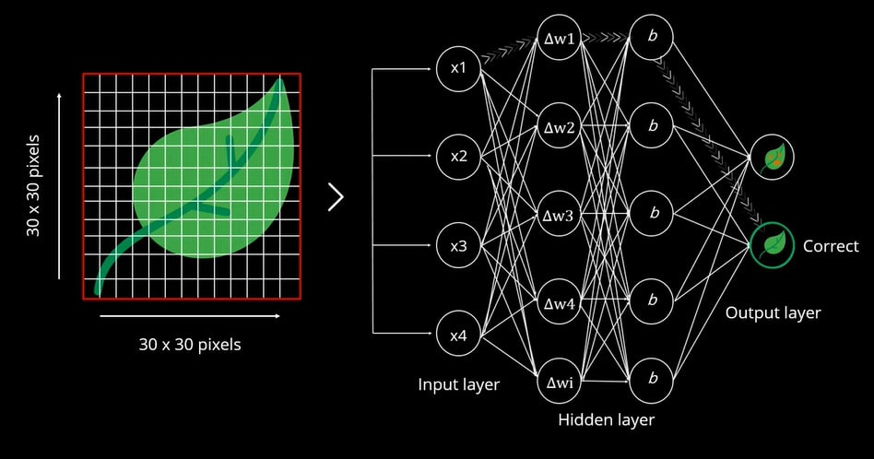
Introduction to Neural networks

Slide 22
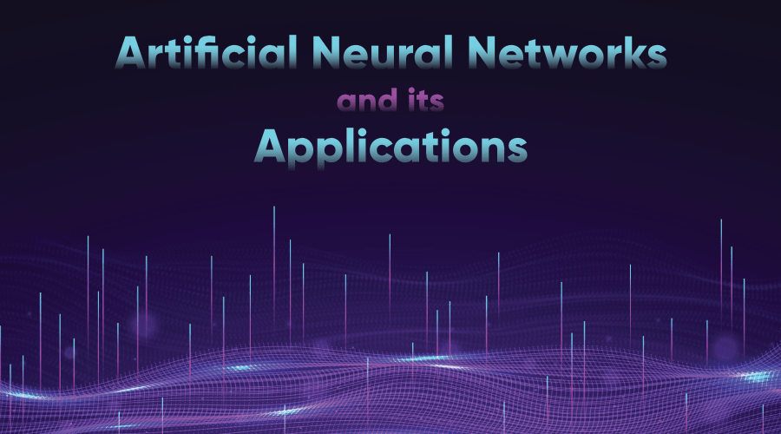
Artificial Neural Network (ANN)

Slide 23
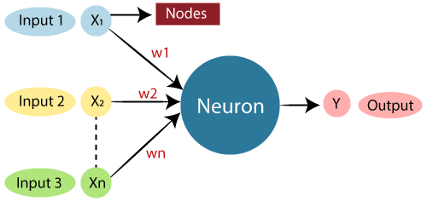

Slide 24
Artificial Neural Network (ANN)
An Artificial Neural Network (ANN) is an information processing paradigm that is inspired by the brain. ANNs, like people, learn by examples. An ANN is configured for a specific application, such as pattern recognition or data classification, through a learning process. Learning largely involves adjustments to the synaptic connections that exist between the neurons.
More…

Slide 25
Convolution Neural Network (CNN)
Artificial Neural Networks contain artificial neurons which are called units. These units are arranged in a series of layers that together constitute the whole Artificial Neural Networks in a system.
A layer can have only a dozen units or millions of units as this depends on the complexity of the system. Commonly, Artificial Neural Network has an input layer, output layer as well as hidden layers.
The input layer receives data from the outside world which the neural network needs to analyze or learn about.
Then this data passes through one or multiple hidden layers that transform the input into data that is valuable for the output layer.
Finally, the output layer provides an output in the form of a response of the Artificial Neural Networks to input data provided.

Slide 26
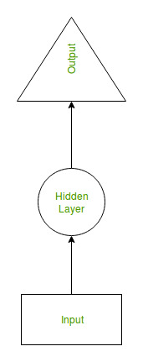
Recurrent Neural Network (RNN)
Recurrent Neural Network(RNN) are a type of Neural Network where the output from previous step are fed as input to the current step.
In traditional neural networks, all the inputs and outputs are independent of each other, but in cases like when it is required to predict the next word of a sentence, the previous words are required and hence there is a need to remember the previous words.
Thus RNN came into existence, which solved this issue with the help of a Hidden Layer.
The main and most important feature of RNN is Hidden state, which remembers some information about a sequence.

Slide 27
RNN have a “memory” which remembers all information about what has been calculated.
It uses the same parameters for each input as it performs the same task on all the inputs or hidden layers to produce the output. This reduces the complexity of parameters, unlike other neural networks.

Slide 28
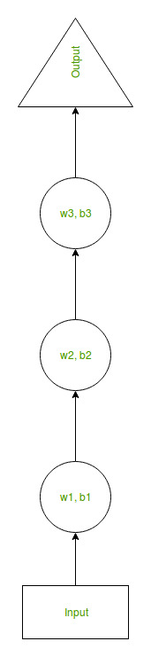
Suppose there is a deeper network with one input layer, three hidden layers and one output layer.
Then like other neural networks, each hidden layer will have its own set of weights and biases, let’s say, for hidden layer 1 the weights and biases are (w1, b1), (w2, b2) for second hidden layer and (w3, b3) for third hidden layer.
This means that each of these layers are independent of each other, i.e. they do not memorize the previous outputs.

Slide 29
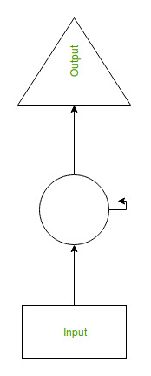
RNN converts the independent activations into dependent activations by providing the same weights and biases to all the layers, thus reducing the complexity of increasing parameters and memorizing each previous outputs by giving each output as input to the next hidden layer.
Hence these three layers can be joined together such that the weights and bias of all the hidden layers is the same, into a single recurrent layer.

Slide 30
Deep learning
Deep learning is a branch of machine learning which is completely based on artificial neural networks, as neural network is going to mimic the human brain so deep learning is also a kind of mimic of human brain.
In human brain approximately 100 billion neurons all together this is a picture of an individual neuron and each neuron is connected through thousand of their neighbors.
The question here is how do we recreate these neurons in a computer. So, we create an artificial structure called an artificial neural net where we have nodes or neurons. We have some neurons for input value and some for output value and in between, there may be lots of neurons interconnected in the hidden layer.

Slide 31
Deep Neural Network – It is a neural network with a certain level of complexity (having multiple hidden layers in between input and output layers). They are capable of modeling and processing non-linear relationships.
Deep Belief Network(DBN) – It is a class of Deep Neural Network. It is multi-layer belief networks.
Steps for performing DBN : a. Learn a layer of features from visible units using Contrastive Divergence algorithm. b. Treat activations of previously trained features as visible units and then learn features of features. c. Finally, the whole DBN is trained when the learning for the final hidden layer is achieved.
Recurrent (perform same task for every element of a sequence) Neural Network – Allows for parallel and sequential computation. Similar to the human brain (large feedback network of connected neurons). They are able to remember important things about the input they received and hence enables them to be more precise.
More

Slide 32
Difference between Machine Learning and Deep Learning :
Machine Learning | Deep Learning
Works on small amount of Dataset for accuracy. | Works on Large amount of Dataset.
Dependent on Low-end Machine. | Heavily dependent on High-end Machine.
Divides the tasks into sub-tasks, solves them individually and finally combine the results. | Solves problem end to end.
Takes less time to train. | Takes longer time to train.
Testing time may increase. | Less time to test the data.

Slide 33
Cognitive computing
Cognitive computing is a branch of computing that uses computerized models to find answers to certain complex problems just like a brain would do. Cognitive computing is basically an amalgamation of neuromorphic and Von Neumann model of computing.
In present times many devices use Artificial Neural Networking (ANN) that are used to mimic the logic the brain works on, to complete some very complicated tasks.
Although ANN is very helpful yet it has a certain limiting point. Such a scenario has given rise to a new form of computing known as Cognitive Computing.

Slide 34
Main Features of Cognitive Computing chips are-
These work in a clockless event-driven fashion leading to a decrease in energy consumption and an increase in performance.
The clockless event-driven fashion here means that unlike traditional processors where each stage of logic has to be synchronized, in cognitive computers each stage can be asynchronous where components of logic can run at different speeds completing the action more quickly.
Neuroplasticity: Cognitive computing chips are fault-tolerant and do not stop working if one of the Neurosynaptic core stops working. The neural net self-adapts and routes through other cores just like our brain does.

Slide 35
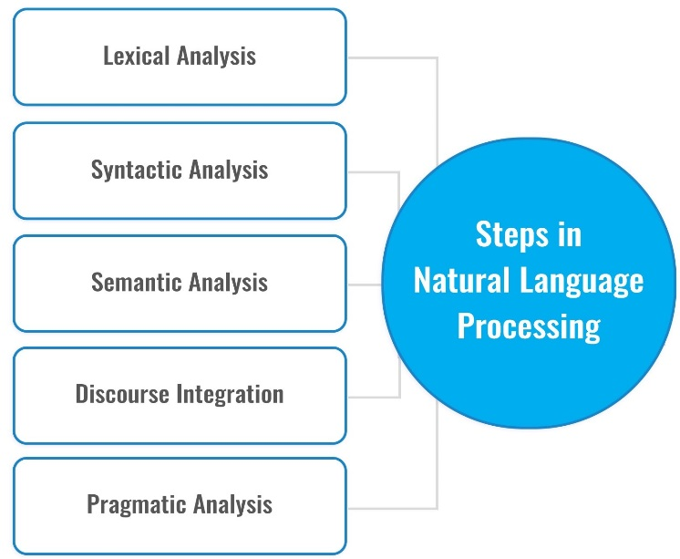
Natural Language processing
The essence of Natural Language Processing lies in making computers understand the natural language.
That’s not an easy task though. Computers can understand the structured form of data like spreadsheets and the tables in the database, but human languages, texts, and voices form an unstructured category of data, and it gets difficult for the computer to understand it, and there arises the need for Natural Language Processing.

Slide 36
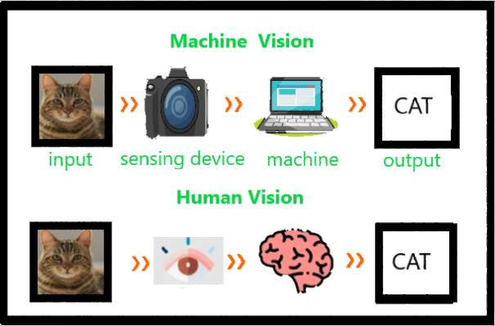
Computer vision

Slide 37
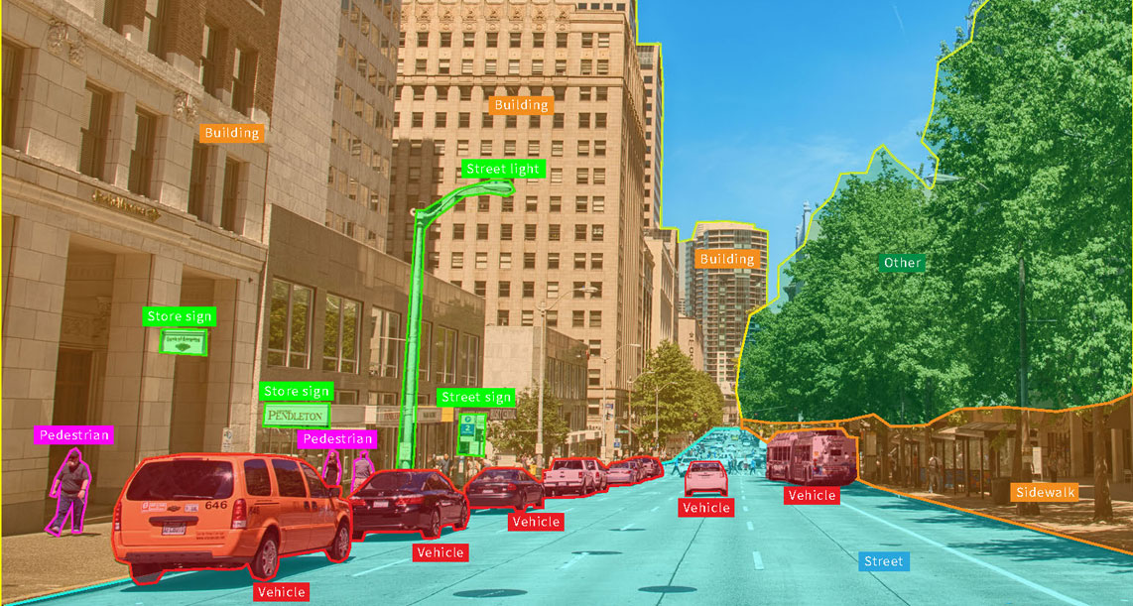
Computer vision

Slide 38
Ever wondered how are we able to understand the things we see? Like we see someone walking, whether we realize it or not, using the prerequisite knowledge, our brain understands what is happening and stores it as information.
Imagine we look at something and go completely blank. Into oblivion. Scary right? Well, the secret behind how our brain interprets the images we see has always intrigued me.
The idea to impart human intelligence and instincts to a computer seems rather effortless. Conceivably, because it is solved by very young children too, but we often tend to forget the limitations of computers as compared to our biological capabilities.
The complexity of vision perception infinitely varies and is ever dynamic in the case of human beings itself, let alone Computer intelligence.

Slide 39
Below are a few key aspects that Computer Vision seeks to recognize in the photographs:
Object Detection: The location of the object.
Object Recognition: The objects in the image, and their positions.
Object Classification: The broad category that the object lies in.
Object Segmentation: The pixels belonging to that object.

Slide 40
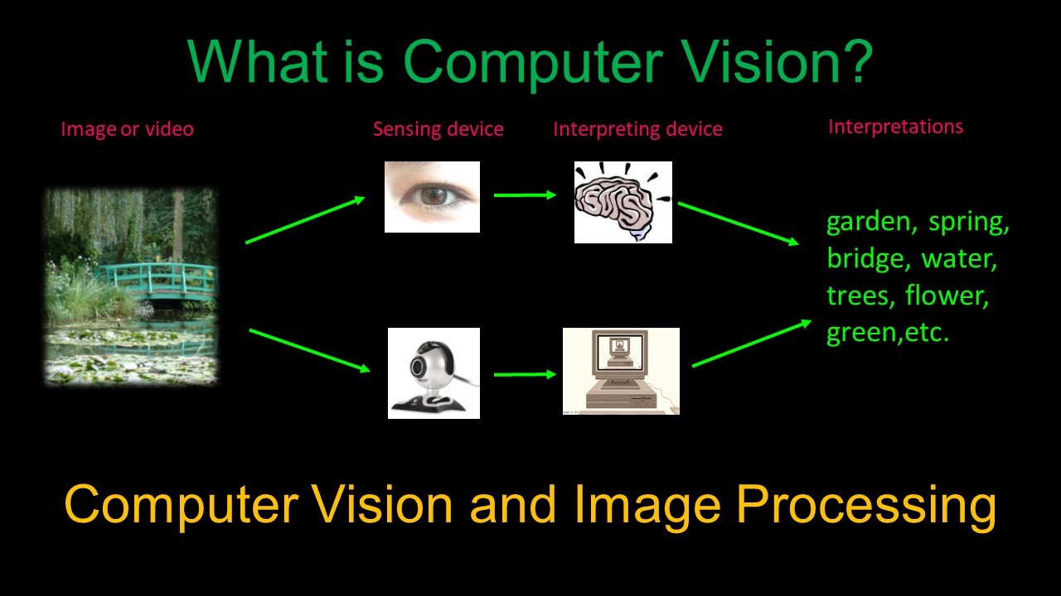
What's it to visualize?

Slide 41
Applications and Future of OpenCV
Computer Vision covers a huge ground as its applications know no bounds. It often escapes our minds as we fail to notice the role Computer Vision plays in the gadgets, we use day in and day out.
Smartphones and Web: Google Lens, QR Codes, Snapchat filters (face tracking), Night Sight, Face and Expression Detection, Lens Blur, Portrait mode, Google Photos (Face, Object and scene recognition), Google Maps (Image Stitching).
Medical Imaging: CAT/MRI
Insurance: Property Inspection and Damage analysis
Optical Character Recognition (OCR)
3D Model Building (Photogrammetry)
Merging CGI with live actors in movies

Slide 42
Role of Artificial Intelligence in Health Care
With the power to perform thousands of complex operations in a second, AI can process vast repositories of medical data into useful insights.
AI is rapidly being incorporated in different areas of medical research, and there have already been some major breakthroughs that threaten to transform the future of medicine.

Slide 43
Applications of AI in Healthcare
Robot Assisted Surgery(Da vinci):
By using AI for creating robots to assist doctors in surgery, the latest discoveries are trying to uncover the secret to minimally invasive surgeries.
Patient Experience:
From optimizing ambulance routes to waiting times using real time data, AI is working towards making healthcare more accessible and efficient for the general public.
Conversational AI is making huge progress in developing chatbots to assist patients, monitor their progress and giving health-specific alerts.

Slide 44
Drug Discovery
Integrating AI with bio-tech platforms is one of the most interesting applications of AI in healthcare today. Several pharmaceutical companies like Pfizer are applying machine learning, in search of immuno-oncology drugs. By finding patterns in medical data, and studying the outcomes of existing drugs on patients, they are trying to discover new combinations of drug ingredients for developing novel drugs.
Medical Data Analysis
With deep learning and cutting edge tools, AI is structuring medical data, to provide doctors and medical researchers with better understanding of the enormous medical data cache.

Slide 45
Radiology
AI is being used to analyze X- ray, CT and MRI scans, to diagnose medical conditions in patients. The computer vision techniques allow programs to detect abnormalities in radiology images, and have reached up to 100% accuracy on test datasets, for several diseases.
Detecting Diseases at an Earlier Stage
Machine learning played a very important role in the early predictions of medical conditions such as heart attacks and diabetes.
There are many AI-based wearables that are being developed to monitor the health of a person and display any warnings when the devices observe something unusual or unlikely.
For eg:- Fitbit and Apple watch. These devices monitor a person’s heart rate, sleep cycle, breathing rate, activity level, blood pressure, so on. It keeps the record of these measures 24×7.

Slide 46
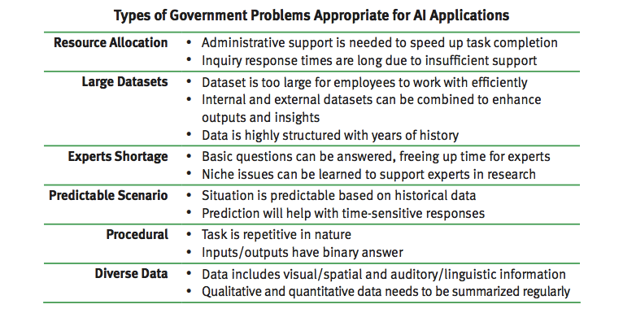

Slide 47
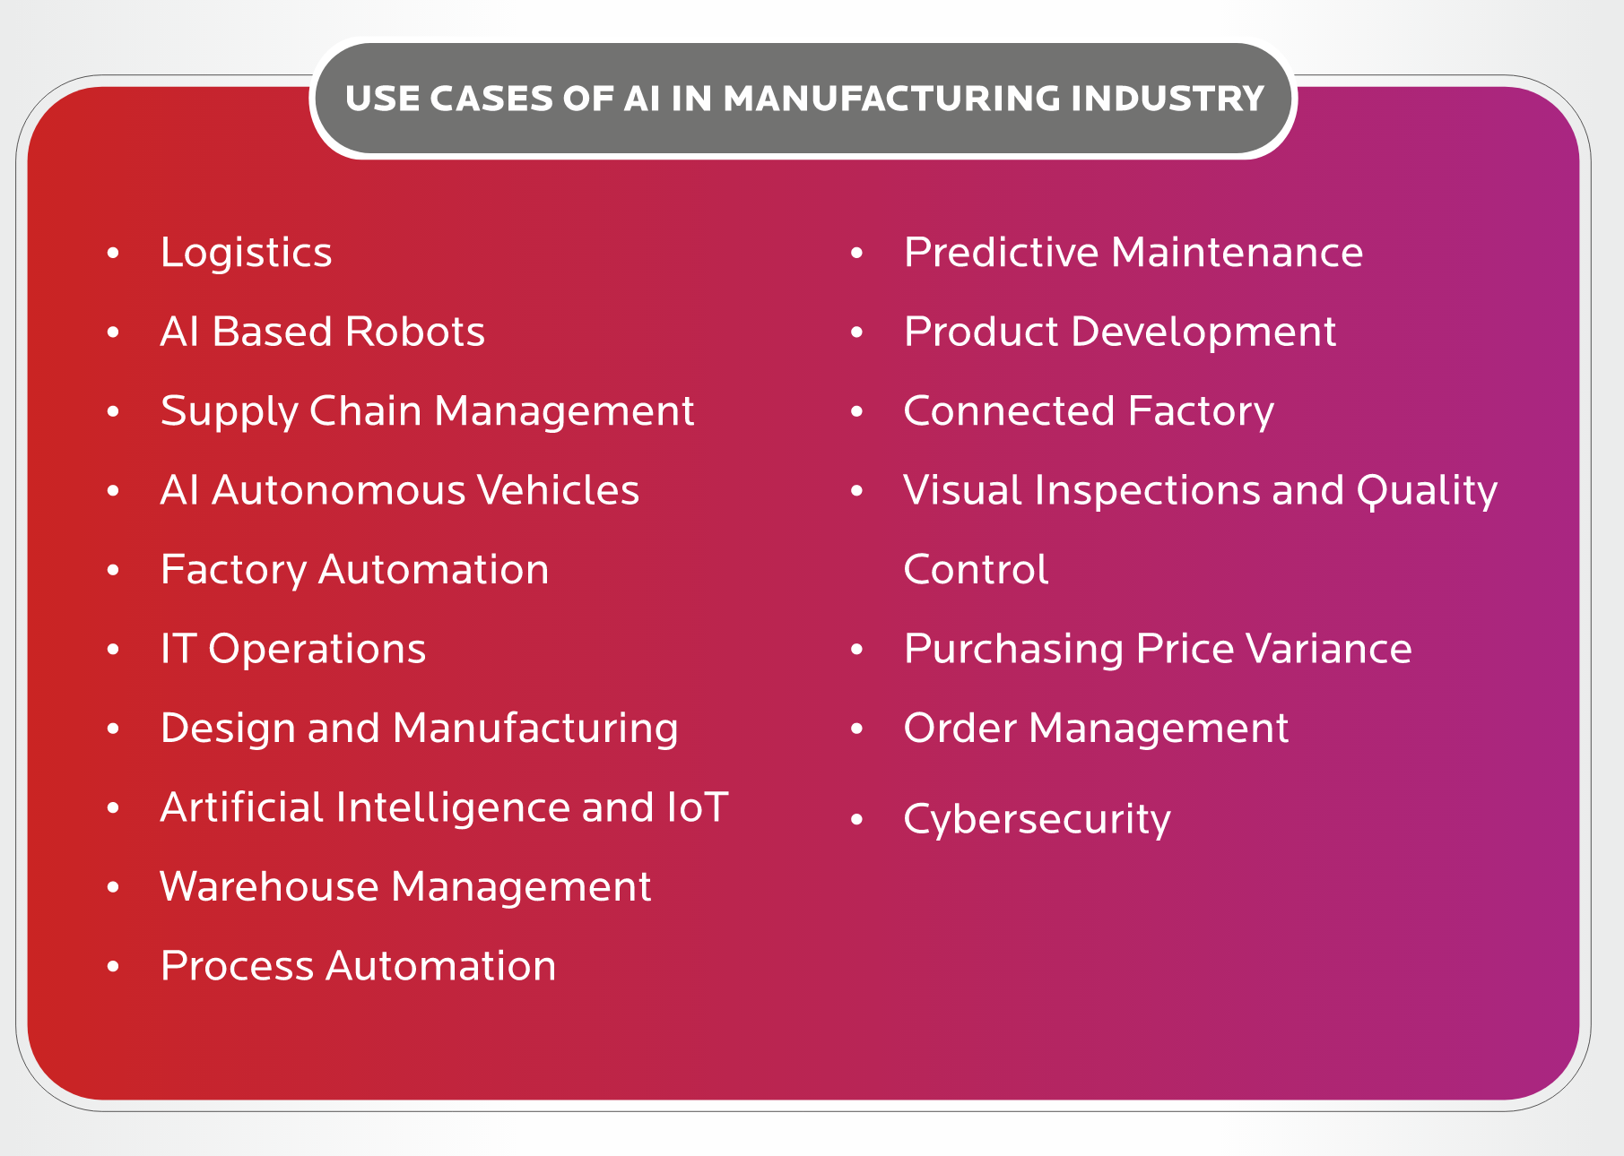

Slide 48
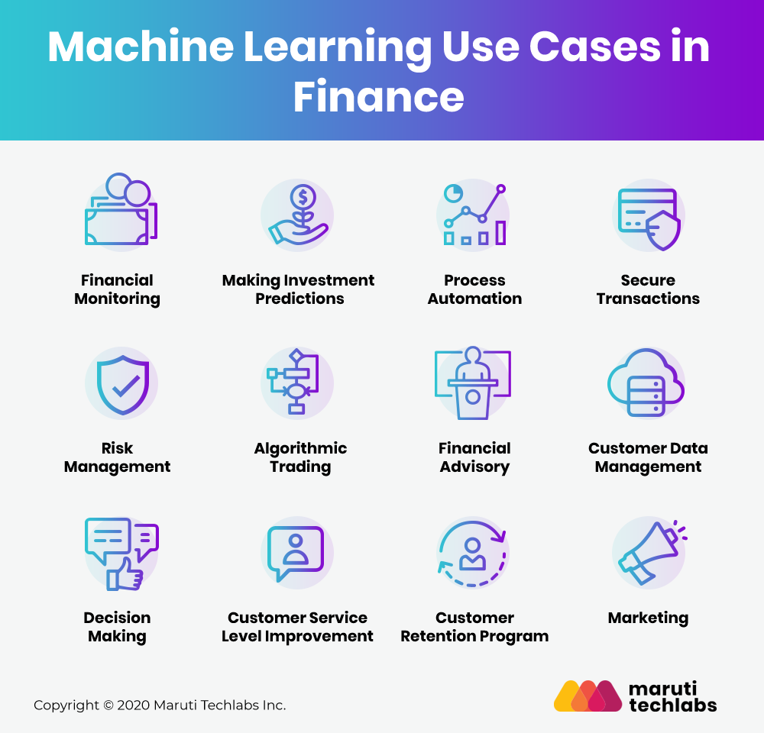

Slide 49
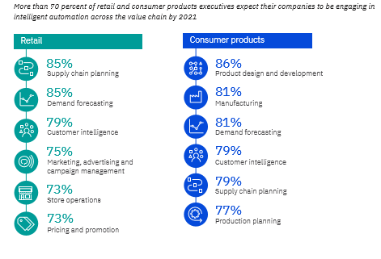

Slide 50
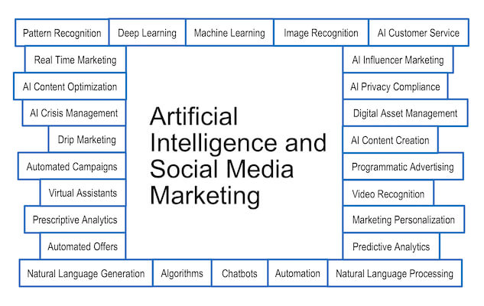

Slide 51
Thank you

